Slide 1
MotoSuiveur (MS) Mounting procedure
Procedimiento de montaje de lo MotoSuiveur(MS) (anteproyecto)

Slide 2
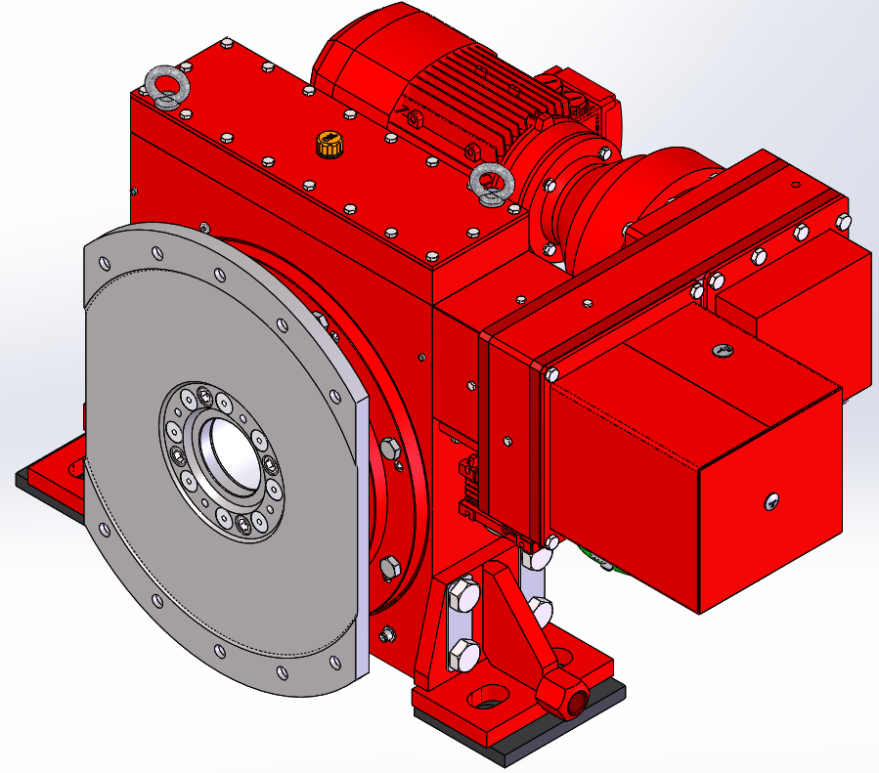
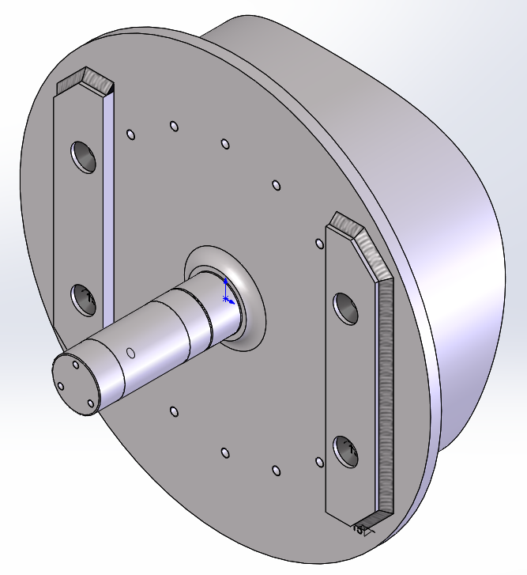
Demag drum and Siguren MS
Use these lugs for lifting / Utiliza estas lengüetas para levantar
New Demag drum with flange and shaft according Siguren drawings
Siguren MotoSuiveur® (MS) with drum adapter for Demag drum
Nuevo tambor Demag con brida y eje según planos de Siguren
Siguren MotoSuiveur® (MS) con adaptador para tambor Demag

Slide 3
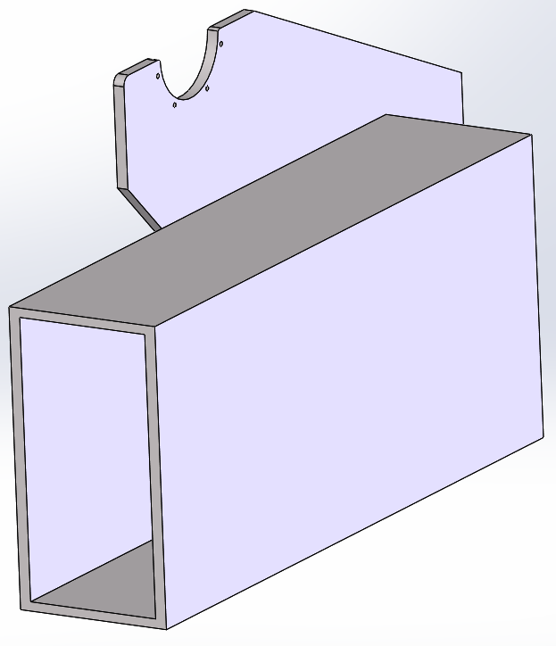
MS seat blocks
Installation area after removal of the existing drum and its bearing
Zona de instalación después de retirar el tambor existente y su cojinete

Slide 4
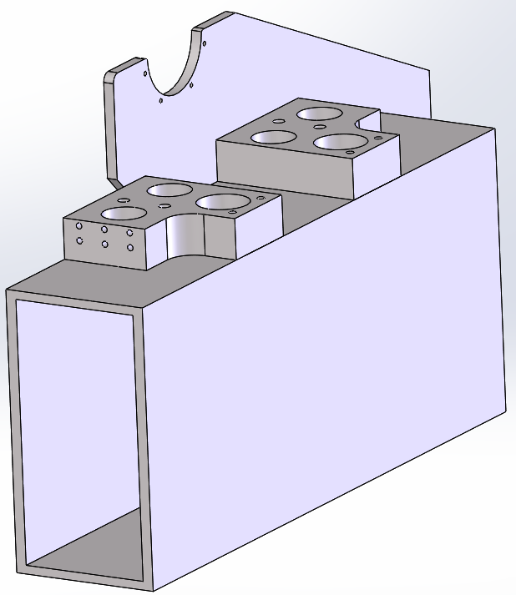
MS seat blocks positioning
2 x 330 mm. Total 660 mm
58 mm
660
(360)
(300)

Slide 5
MS seat blocks
Welds inside the circumference of the holes
Soldaduras dentro de la circunferencia de los agujeros
Welds on all accessible edges
Soldaduras en todos los bordes accesibles
Seat blocks to be welded to the crane trolley beam
Bloques de asiento para soldar a la viga del carro de la grúa

Slide 6
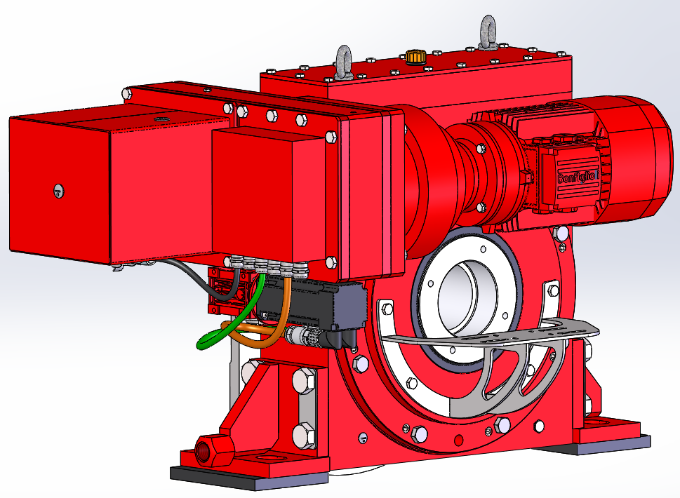
Drum – MS assembly
It will be more comfortable to remove the geared limit switch bracket
Remove 5 bolts M10

Slide 7
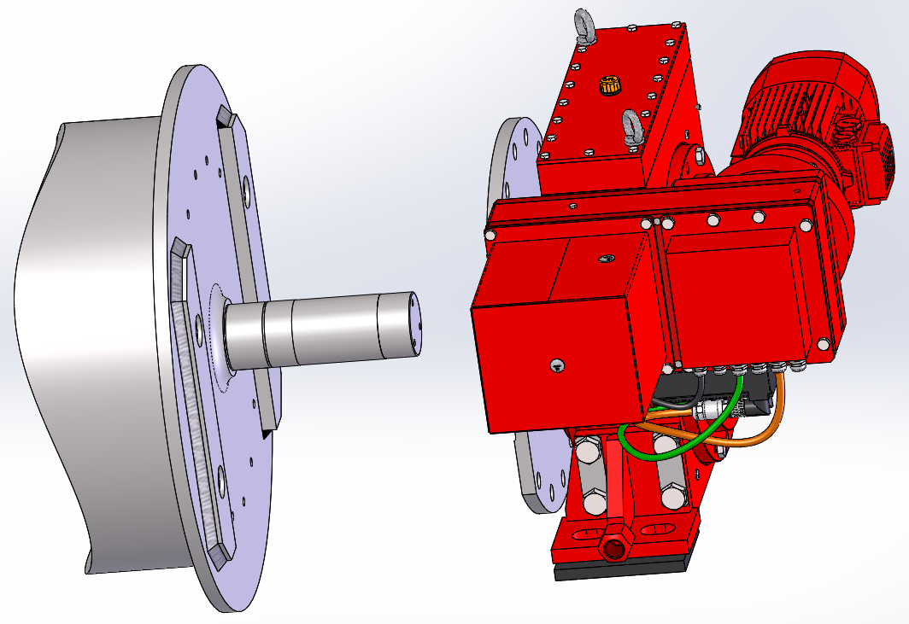
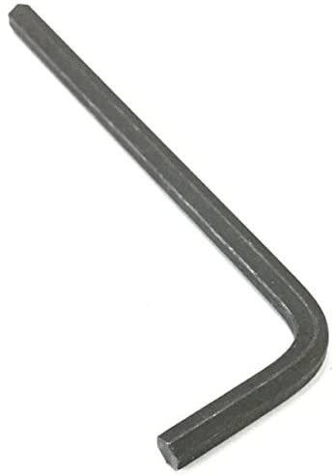
Drum – MS assembly
If the flat sides are not parallel:
- Easiest way is to rotate the barrel
- If you can’t rotate the barrel do the following:
1. Remove this plug.
2. Put the allen key S12 in the hole. Minimum length of 150 mm
3. Rotate the worm with the allen key in the ANTICLOCKWISE direction.
If you rotate the worm in clockwise direction there has a possibility to block the MS.
Both flat sides should be parallel

Slide 8
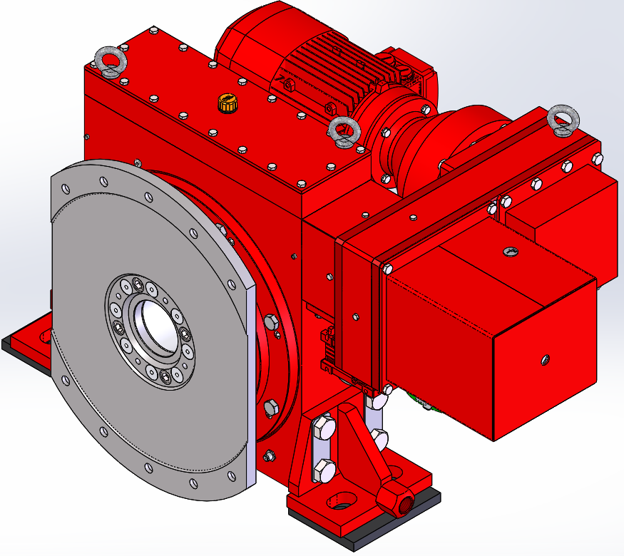
Unblocking the MS
1. Rotate the adapter plate in clockwise rotation till it stops
2. Put the allen key S12 in the hole and rotate it in the ANTICLOCKWISE direction and release the locking mechanism

Slide 9
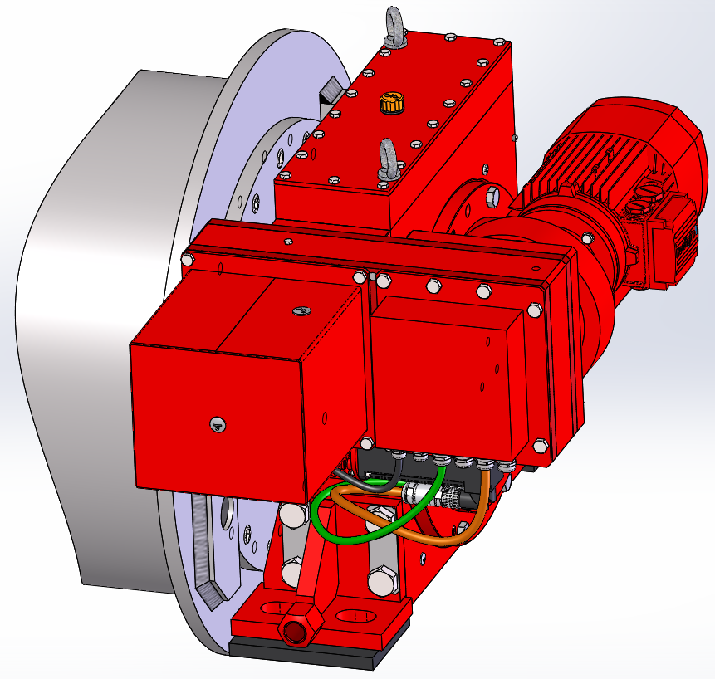
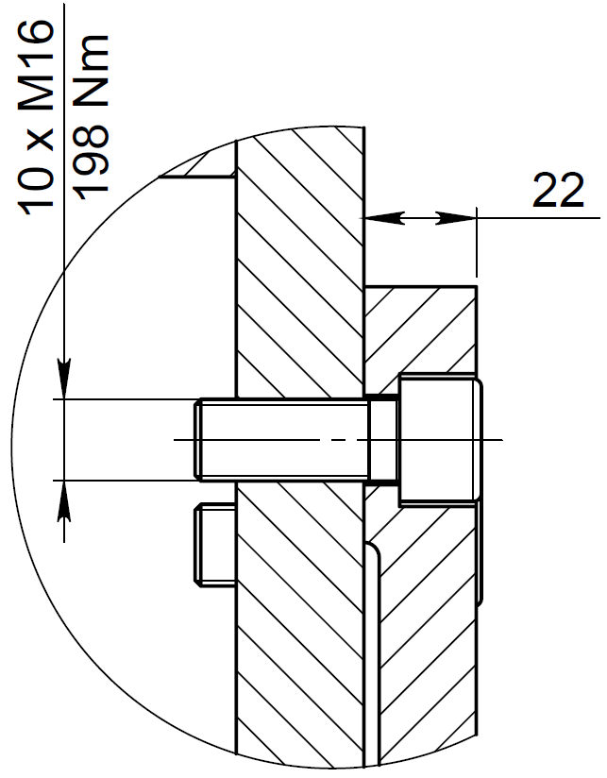
Drum – MS assembly
10 bolts M16
Tightening torque – 198 Nm
Assemble the MS to the drum and secure it with the bolts M16. At this point, the hoist gearbox may also be assembled to the opposite end of the drum (depending on Demag drum replacement procedure).
Montar la MS en el tambor y fijarla con los tornillos M24. En este punto, la caja de engranajes del polipasto también puede montarse en el extremo opuesto del tambor (dependiendo del procedimiento de sustitución del tambor Demag).

Slide 10
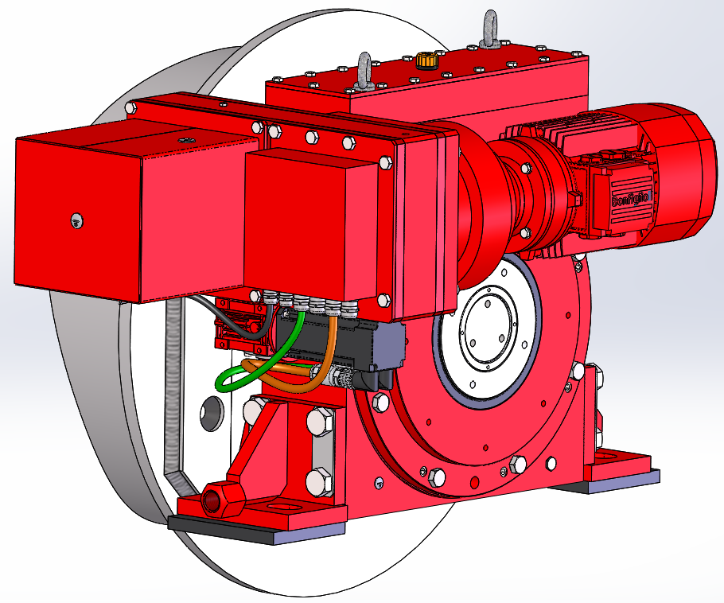
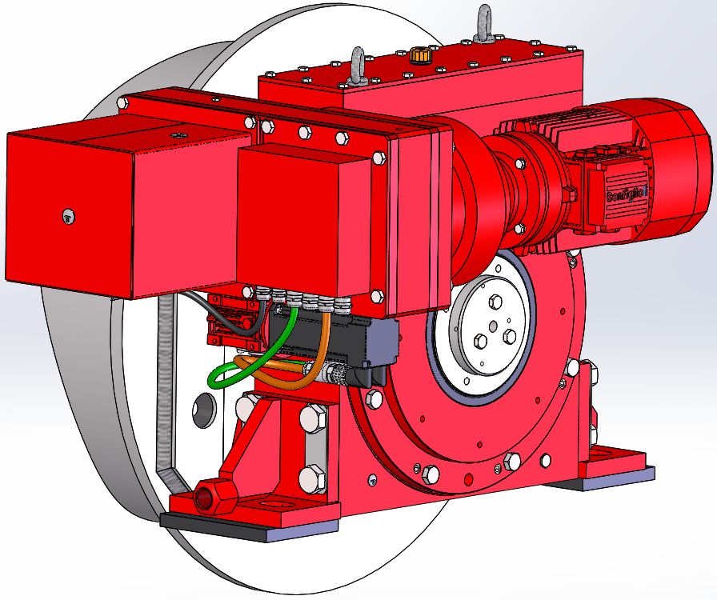
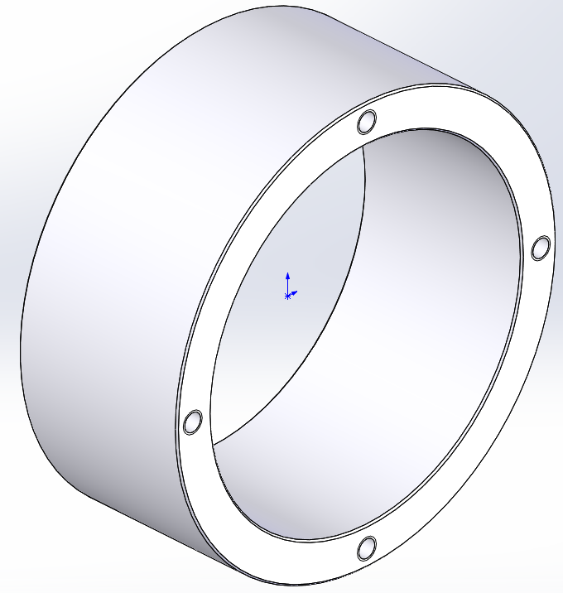
Drum – MS assembly
Insert the centering bush
Mount the stop washer – 3xM12 hexagon head screws
Tightening torque – 79 Nm

Slide 11
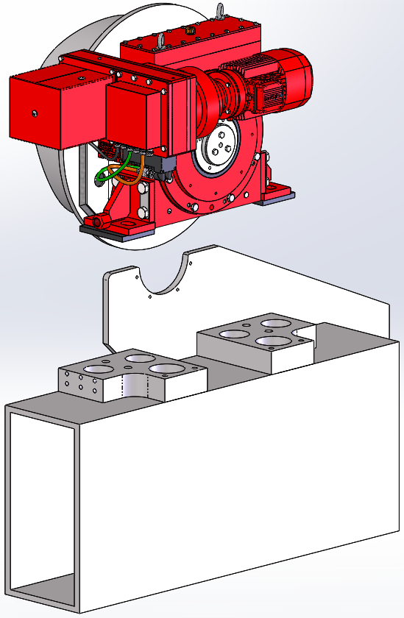
415 mm to pass
415 mm para pasar
Land the (Gearbox/ ) drum / MS assembly on the seat blocks
Aterrice el conjunto (lcaja de engranajes / ) tambor / MS en los bloques de asiento

Slide 12
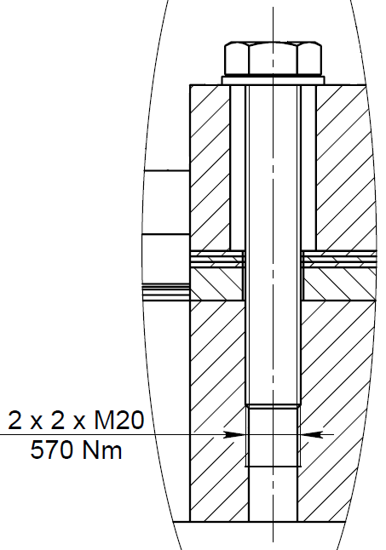
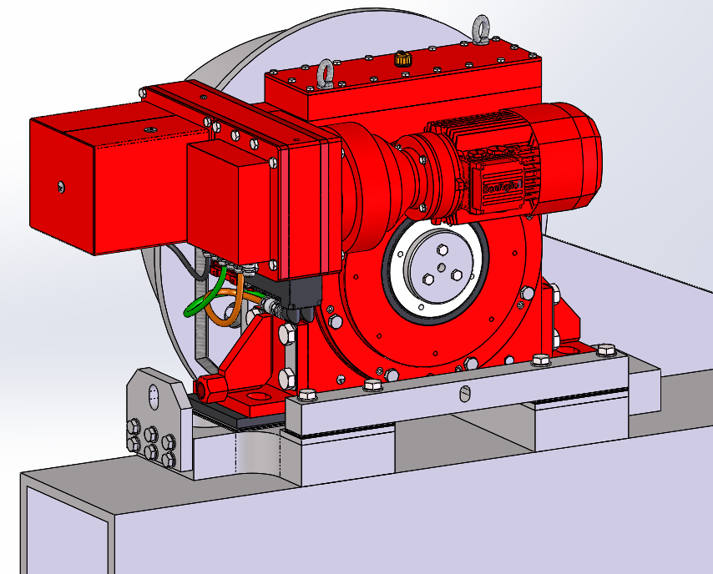
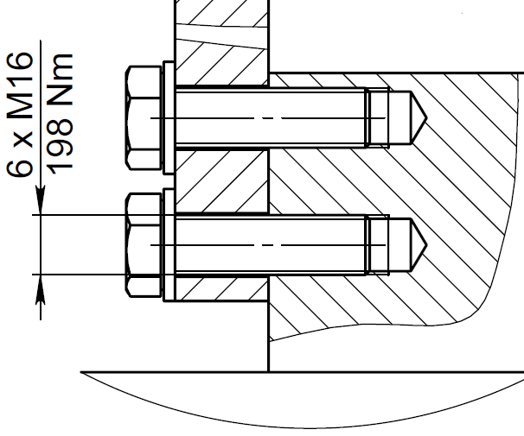
4 x M20 Hexagon head screws + plain washers
Tightening torque – 570 Nm
Elastomer pad
Distance plates
Support bar
MS side support plate
Distance plates
6 x M16 Hexagon head screws + plain washers
Tightening torque – 198 Nm
Mount the Radial and the Axial adjustment parts
Montar las piezas de ajuste radial y axial

Slide 13
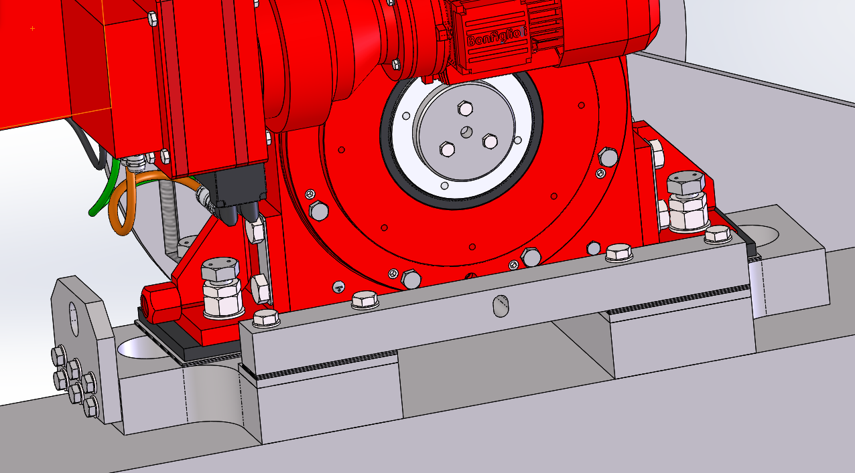
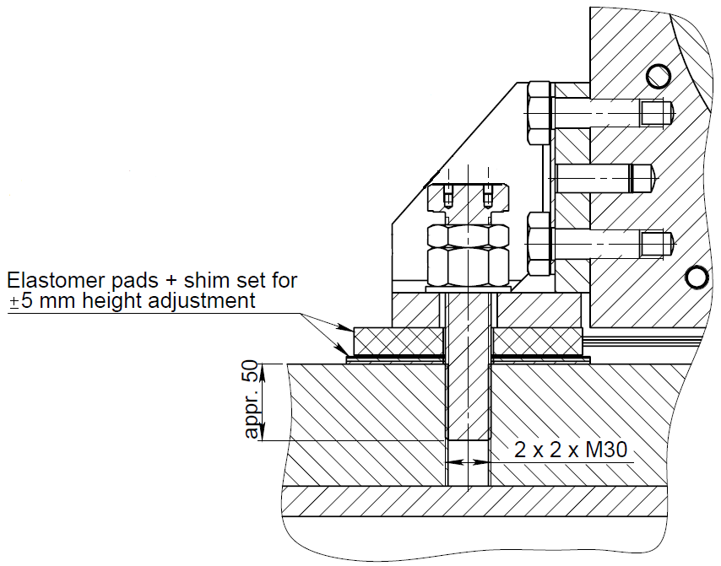
Mount the bolts M30 on the MS feet. Do not tight the bolts at this point.
Monte los tornillos M30 en las patas MS. No apriete los pernos en este punto.

Slide 14
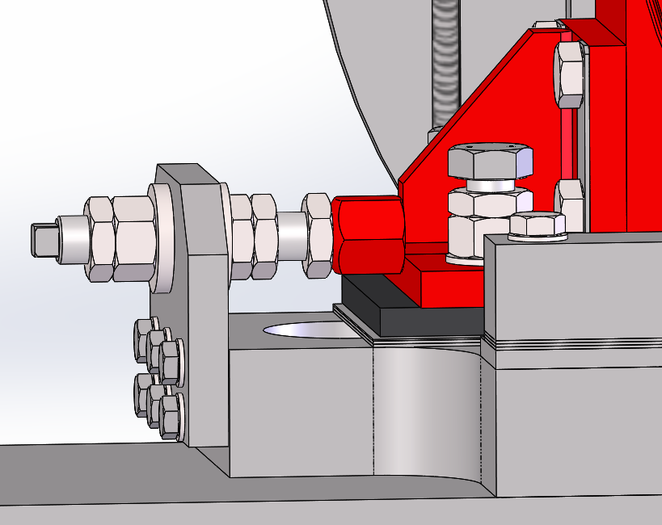
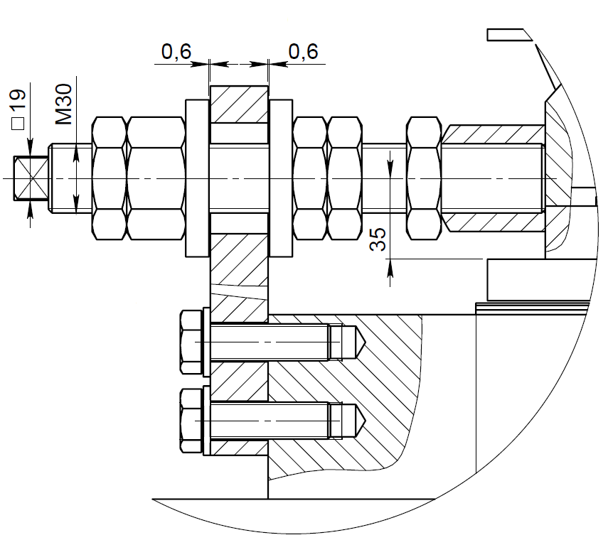
Adjust the radial position of the drum by using the nuts
Ajuste la posición radial del tambor mediante las tuercas

Slide 15
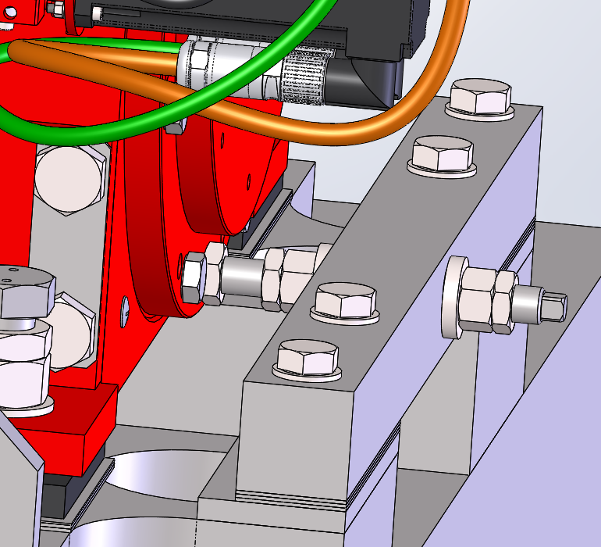
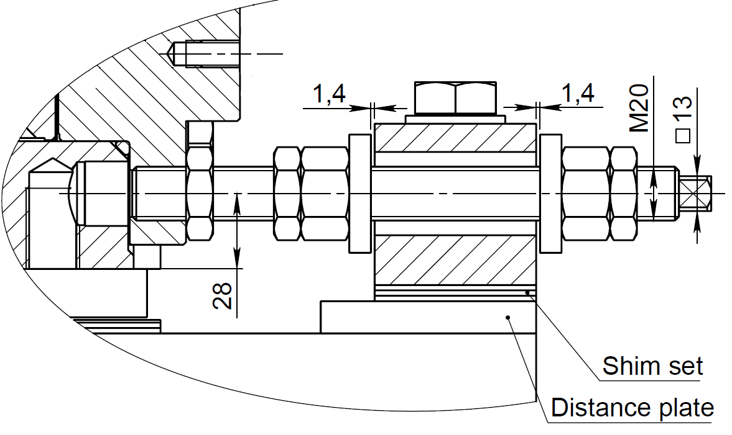
Adjust the axial position of the drum by using the nuts
Ajuste la posición axial del tambor mediante las tuercas

Slide 16
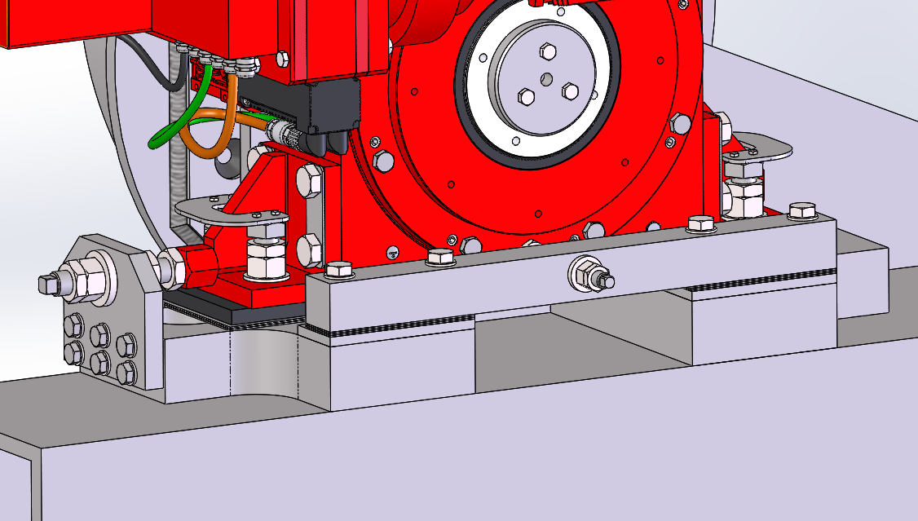
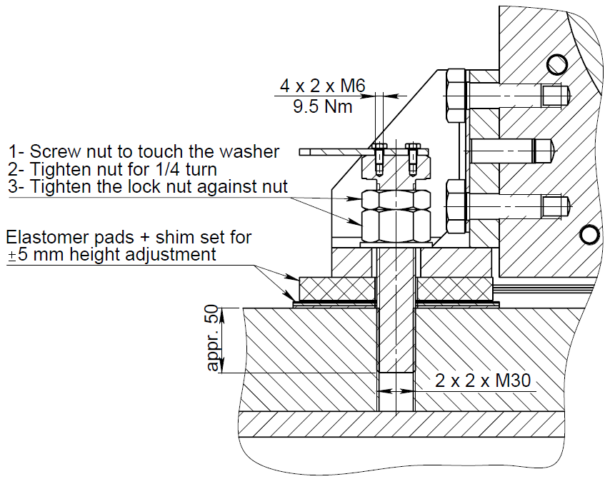
Once the drum is at its correct position, tight all nuts to the prescribed torque and secure the feet bolts heads with the provided plates and screws M6
Una vez que el tambor esté en su posición correcta, apriete todas las tuercas con el par de apriete prescrito y fije las cabezas de los pernos de las patas con las placas y los tornillos M6 suministrados

Slide 17
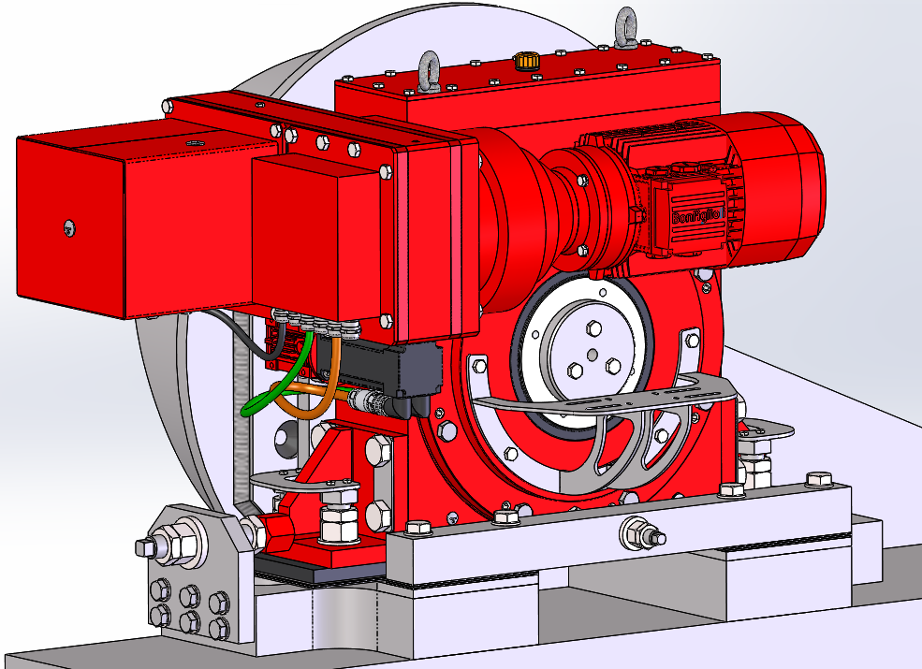
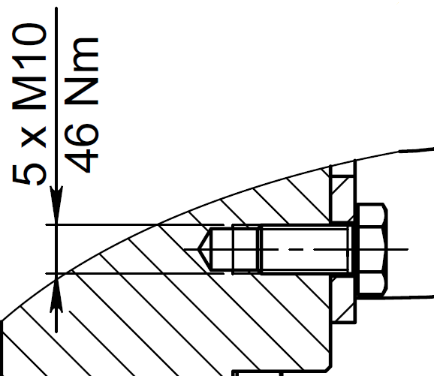
Install the rotary end switch bracket:
5 x M10 Hexagon head screws
Tightening torque – 198 Nm

Slide 18
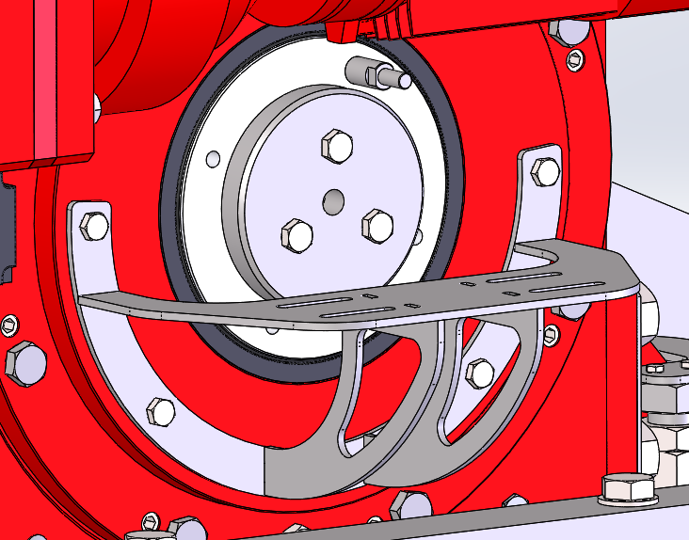
Install the rotary end switch drive pin:
Tightening torque – 79 Nm

Slide 19
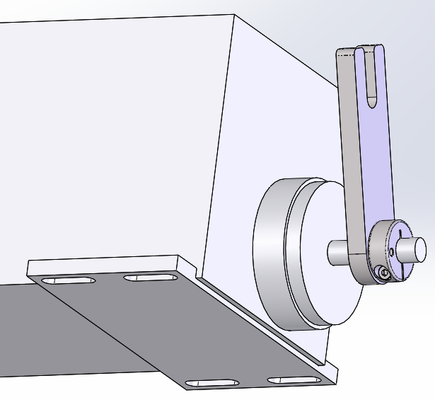
Put the drive plate assy on the rotary end switch shaft
Do not lock it to the shaft at this time

Slide 20
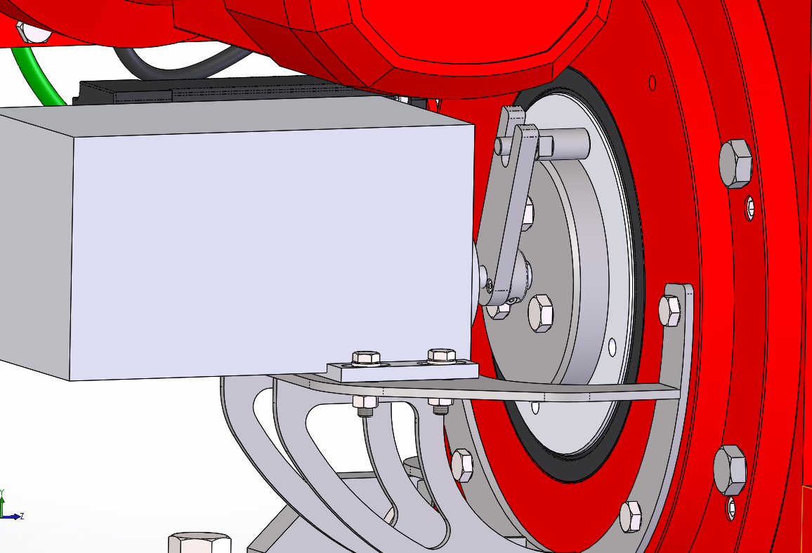
2. Install the rotary end switch on the bracket
3. Set the position of drive plate assy and lock it to the rotary end switch shaft
Tightening torque – 4 Nm
1. Install the rotary end switch on the bracket

